Slide 1
MATH221
Mathematics for Computer Science
Unit 5
Relations and Functions

Slide 2
OBJECTIVES
Understand what is a relation and function.
Determine the domain and range of relation and function.
Evaluate the properties of relation such as reflexivity, symmetry and transitivity.
Understand what is a function, one-to-one and onto function
Find the existence of inverse function.

Slide 3
Unit 5a
Relations

Slide 4
Cartesian Product
Given two sets A and B, the Cartesian product of A and B, denoted by A × B (read “A cross B”), is the set of all ordered pairs (a, b), where a is in A and b is in B.
Symbolically,
A × B = {(a, b): a ∈ A and b ∈ B}

Slide 5
Cartesian Product: Example
Let A = {x, y}, B = {1, 2, 3}, C = {a, b}. Find the followings.
a. A × B b. (A × B) × C
a. A × B = {(x, 1), (x, 2), (x, 3), (y, 1), (y, 2), (y, 3)}
b. (A × B) × C = {(u, v): u ∈ A × B and v ∈ C}
= {((x, 1), a), ((x, 2), a), ((x, 3), a), ((y, 1), a), ((y, 2), a), ((y, 3), a), ((x, 1), b), ((x, 2), b), ((x, 3), b), ((y, 1), b), ((y, 2), b), ((y, 3), b)}

Slide 6
Relations
Let A and B be sets. We say that R is a (binary) relation from A to B if R ⊆ A × B.
If R ⊆ A × A, we will say that R is a relation on A.
Further, if (a, b) ∈ R, we will frequently write aRb and say that “a is related to b by R”, symbolically, denoted as aRb.

Slide 7
Discussion:
Consider the relation R on ℝ given by
R = {(x, y): x, y ∈ ℝ ∧ x = y}.
(i) We can sketch a graph of this relation as follows:
y
y = x
x

Slide 8
Discussion:
(ii) True of False? 1R1
True
2.1R2.2
False
(-3, 3) ∈ R
False
(iii) If aR100, then a = 100.

Slide 9
Relations: Notes
The relation in the previous discussion is usually written as
R = {(x, x): x ∈ ℝ}
and it is normally called the identity relation on ℝ.

Slide 10
Examples:
1. Let X = {0, 1, 2, 3} and let the relation R on X be given by R = {(x, y): ∃z ∈ ℕ, x + z = y}.
(i) What is an easier way of expressing the relation R?
R = {(x, y): (x, y ∈ X)∧(x < y)}.
(ii) List all the elements of R.
R = {(0, 1), (0, 2), (0, 3), (1, 2), (1, 3), (2, 3)}

Slide 11
Examples:
(iii) Sketch X × X and circle the elements of R.
y
3
2
1
0
1
2
3
x

Slide 12
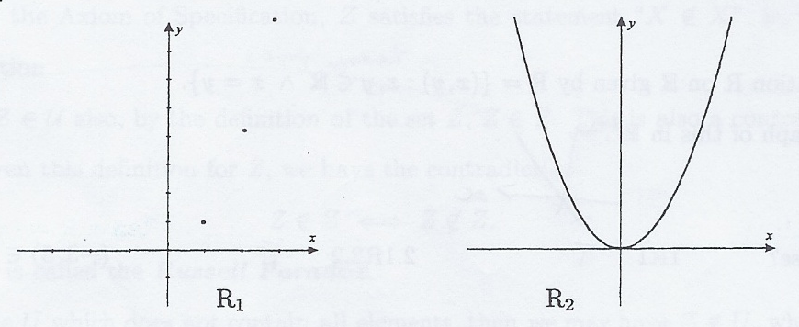
Examples
2. Let R₁ be the relation on ℕ given by R₁ = {(x, y): y = x²}.
Let R₂ be the relation on ℝ given by R₂ = {(x, y): y = x²}. By sketching each relation, we can see how the “input set” makes a difference to the elements in the relation

Slide 13
Relation: Note
We must be careful when writing relations. If a relation involves two different sets, we must make very clear the sets a relation R is from and to.
Since relations are subsets of cartesian products, their unions and intersections can be calculated as for any sets.

Slide 14
Example:
Let A = {0, 1} and B = {-1, 0, 1}. Let two relations from A to B be given by
R₁ = {(0, -1), (1, -1), (1, 0)},
and R₂ = {(0, 0), (1, 1), (1, -1)}.
Write down R₁ ∩ R₂ and R₁ ∪ R₂.
R₁ ∩ R₂ = {(1, -1)}
R₁ ∪ R₂ = {(0, -1), (0, 0), (1, -1), (1, 0), (1, 1)}.3

Slide 15
Domain and Range of Relations
Let R be a relation from A to B.
Then the domain of R, denoted by Dom R, is given by
Dom R = {x: ∃y, xRy}
and the range of R, denoted Range R, is given by
Range R = {y: ∃x, xRy}

Slide 16
Examples:
1. Let A = {0, 1, 2, 3} and let R be a relation on A given by R₁ = {(0, 0), (0, 1), (0, 2), (3, 0)}.
Write down Dom R₁ and Range R₁.
Dom R₁ = {0, 3}
Range R₁ = {0, 1, 2}
2. Let R₂ be the relation on ℤ given by R₂ = {(x, y): xy ≠ 0}.
What are Dom R₂ and Range R₂.
Dom R₂ = ℤ - {0}
Range R₂ = ℤ - {0}

Slide 17
Examples:
3. Let R₃ be the relation from ℤ to ℚ given by
R₃ = {(x, y): x ≠ 0 ∧ y =1/x }.
Find Dom R₃ and Range R₃.
Dom R₃ = ℤ - {0}
Range R₃ = {1/n: n ∈ ℤ ∧ n ≠ 0}

Slide 18
Domain and Range of Relations: Notes
1. Let R be a relation from A to B. Then Dom R ⊆ A and Range R ⊆ B.
2. We could say that Dom R is the set of all first elements in the ordered pairs that belong to R.
Range R is the set of all second elements in the ordered pairs that belong to R.

Slide 19
Inverse Relations
Let R be a relation from A to B.
We define the inverse relation, R⁻¹, from B to A as
R⁻¹ = {(y, x): (x, y) ∈ R}.

Slide 20
Inverse Relations: Example
Consider the relation R from A = {a, b, c} to B = {1, 2, 3, 4}.
R = {(a, 1), (b, 2), (c, 3), (a, 4)}.
The inverse relation, R⁻¹, is simply each ordered pair written “in reverse”.
R⁻¹ = {(1, a), (2, b), (3, c), (4, a)}.

Slide 21
Inverse Relations: Example
2. Define a relation R on ℕ as R = {(x, y): y = 2x}.
(i) Write down three elements of R. Write down three elements of R⁻¹.
Three elements of R : (1, 2), (2, 4), (3, 6)
Three elements of R⁻¹ : (2, 1), (4, 2), (6, 3)

Slide 22
Inverse Relations: Example
2. (ii) Sketch a graph of R and R⁻¹ on coordinate axes.
y
4
R
3
2
R⁻¹
1
0
1
2
3
4
x

Slide 23
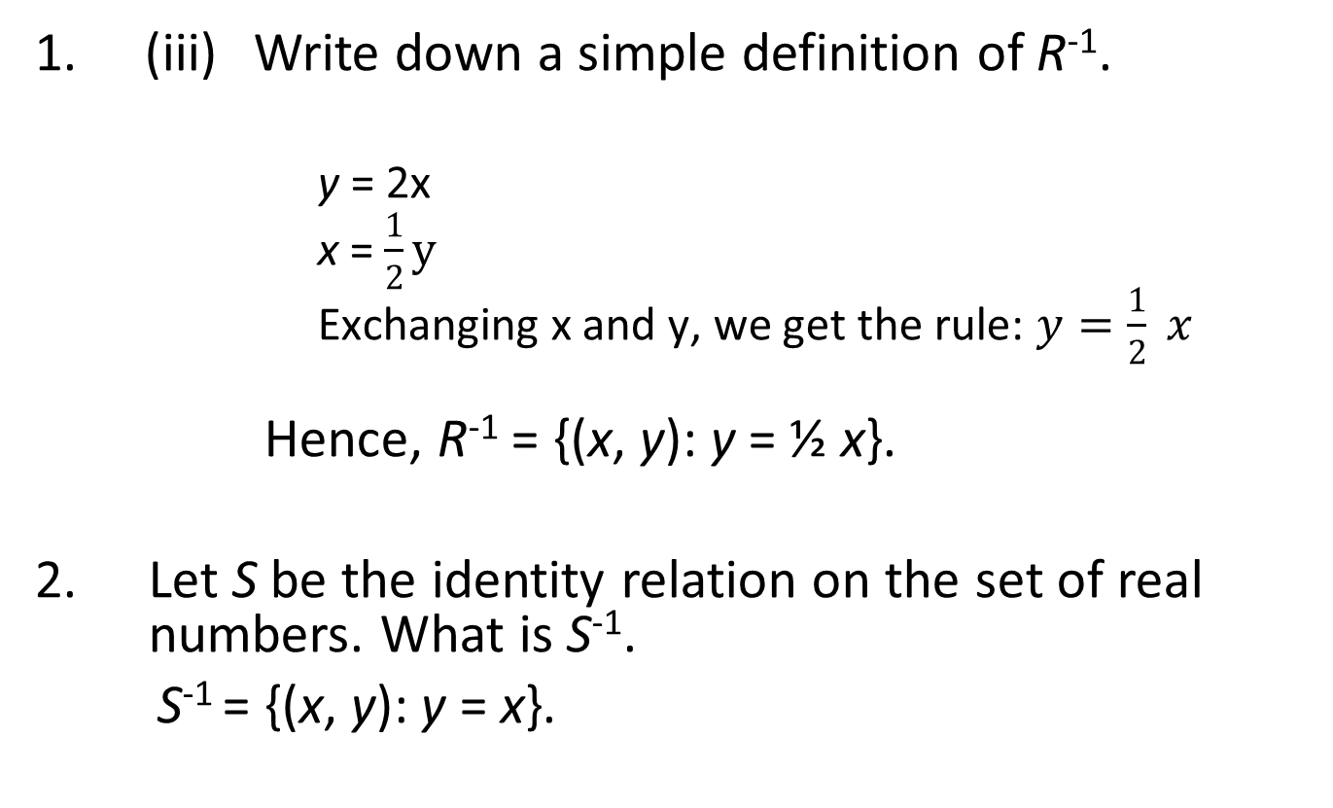
Examples:
1. (iii) Write down a simple definition of R⁻¹.
          y = 2x
          x = $\frac{1}{2}y$
          Exchanging x and y, we get the rule: $y=\frac{1}{2} x$
      Hence, R⁻¹ = {(x, y): y = ½ x}.
2. Let S be the identity relation on the set of real numbers. What is S⁻¹.
S⁻¹ = {(x, y): y = x}.

Slide 24
Reflexivity
Let R be a relation on the set A.
R is reflexive on A if and only if ∀x ∈ A, (x, x) ∈ R.

Slide 25
Reflexivity: Example
Let R₁ be a relation on ℕ defined by
R₁ = {(x, y): x is a factor of y}.
For each x ∈ ℕ, we know that x is a factor of itself.
Thus, (x, x) ∈ R₁ and so R₁ is reflexive.
Informally, a relation R on a set A is reflexive if each element in A is related to itself by R.

Slide 26
Symmetry
Let R be a relation on the set A.
R is symmetric on A if and only if
∀x, y ∈ A, ((x, y) ∈ R ⇒ (y, x) ∈ R).

Slide 27
Symmetry: Example
Let R₂ be the identity relation on ℝ.
Let (x, y) ∈ R₂. Then, x, y ∈ ℝ and x = y. This implies that y = x. Hence, (y, x) ∈ R₂. So, R₂ is symmetric.
Informally, a relation R on a set A is symmetric if you can “swap” the ordered pairs around and still get elements of R.

Slide 28
Transitivity
Let R be a relation on the set A.
R is transitive on A if and only if
∀x, y, z ∈ A, ((x, y) ∈ R ∧ (y, z) ∈ R) ⇒ (x, z) ∈ R).

Slide 29
Transitivity: Example
Let R₃ be the relation on ℤ defined by
R₃ = {(x, y): x < y}.
Let (x, y) ∈ R₃ and (y, z) ∈ R₃. Since (x, y) ∈ R₃, x < y. Since (y, z) ∈ R₃ , y < z. This implies that x < z. Hence, (x, z) ∈ R₃. Therefore, R₃ is transitive.

Slide 30
Equivalence Relations
Let R be a relation on the set A.
R is an equivalence relation on A if and only if R is reflexive, symmetric and transitive on A.

Slide 31
Verifying/Proving Reflexivity, Symmetry and Transitivity
Finite Relation:
  Use Method of Exhaustion discussed in Unit 3 to verify all the cases.
Infinite Relation:
  Use a generalized method of proof discussed in Unit 3 (usually direct proof) to verify the properties based on the definition of the relation.
Examples on both are given after this slides.

Slide 32
Equivalence Relations: Examples
1. Let R₁ be a identity relation on ℝ. Then R₁ is an equivalence relation.
Proof:
Reflexive: ∀a ∈ ℝ, a = a, that is, (a, a) ∈ R₁.
Thus, R₁ is reflexive.
Symmetric: ∀a, b ∈ ℝ, if (a, b) ∈ R₁, then a = b.
Thus, b = a, and hence, (b, a) ∈ R₁.
Hence, R₁ is symmetric.
Transitive:
∀a, b, c ∈ ℝ, if (a, b) ∈ R₁ and (b, c) ∈ R₁, then a = b and b = c. Thus, a = c, and hence (a, c) ∈ R₁.
Therefore, R₁ is transitive.
Therefore, R₁ is an equivalence relation.

Slide 33
Equivalence Relations: Examples
2. Let R₂ be the relation on ℤ given by
R₂ = {(a, b): ab ≠ 0}.
Reflexive: We must show ∀a ∈ ℤ, a × a ≠ 0.
But, we note that 0 ∈ ℤ and 0 × 0 = 0.
Hence, (0, 0) ∉ R₂ .
Therefore, R₂ is NOT reflexive.
Therefore, R₂ is not an equivalence relation.

Slide 34
Discussion:
Consider the relation R₂ on ℤ given by
R₂ = {(a, b): ab ≠ 0}.
(i) Is R₂ symmetric or transitive?
Symmetric:
∀a, b ∈ ℤ, if (a, b) ∈ R₂, then ab ≠ 0.
This implies that ba ≠ 0.
Thus, then (b, a) ∈ R₂.
Hence, R₂ is symmetric.
Transitive:
∀ a, b, c ∈ ℤ, if (a, b) ∈ R₂ and (b, c) ∈ R₂, then ab ≠ 0 and bc ≠ 0.
This implies that ac ≠ 0.
Thus, (a, c) ∈ R₂.
Hence, R₂ is transitive.

Slide 35
Discussion:
(ii) How can we adjust the relation so that it becomes and equivalence relation?
Adjust ℤ to ℤ - {0}.

Slide 36
Equivalence Relations: Notes
1. To prove a relation R is an equivalence relation, you must prove all three properties.
2. To disprove that a relation R is an equivalence relation, you must show that one of the three properties does not hold, usually by counterexample.

Slide 37
Equivalence Relations: Example
Let A = {0, 1, 2} and let R be the relation on A given by
R = {(0, 0), (1, 1), (2, 2), (0, 1), (1, 0)}.
Prove R is an equivalence relation on A.
Reflexive: For a = 0: (0, 0) ∈ R.
For a = 1: (1, 1) ∈ R.
For a = 2: (2, 2) ∈ R.
So, ∀a ∈ A, (a, a) ∈ R.
Thus, R is reflexive.

Slide 38
Equivalence Relations: Example
Symmetric: We must check each ordered pair (a, b) ∈ R to see if (b, a) is also in the relation.
For (0, 0), (1, 1), (2, 2) symmetry obviously holds.
For (0, 1), we need to check that (1, 0) ∈ R, which it is.
For (1, 0), we need to check that (0, 1) ∈ R, which it is
Thus, R is symmetric.

Slide 39
Equivalence Relations: Example
Transitive:
We must check each pair of elements (a, b), (b, c) ∈ R that (a, c) ∈ R.
(0, 0), (0, 1) ∈ R, so (0, 1) should be in R, which it is.
(1, 1), (1, 0) ∈ R, so (1, 0) should be in R, which it is.
(0, 1), (1, 1) ∈ R, so (0, 1) should be in R, which it is.
(0, 1), (1, 0) ∈ R, so (0, 0) should be in R, which it is.
(1, 0), (0, 1) ∈ R, so (1, 1) should be in R, which it is.
(1, 0), (0, 0) ∈ R, so (1, 0) should be in R, which it is.
Thus, R is transitive.
Therefore, R is an equivalence relations.

Slide 40
Equivalence Class
Let R be an equivalence relation on the set A.
Then for each a ∈ A, we define the equivalence class of a as
Class(a) = {b ∈ A: (a, b) ∈ R}.

Slide 41
Equivalence Class: Examples
Consider the relation R in the previous example.
R = {(0, 0), (1, 1), (2, 2), (0, 1), (1, 0)}.
    For each element in a, we write the equivalence classes as follows.
    Class(0) = {b ∈ A: (0, b) ∈ R} = {0, 1}
    Class(1) = {b ∈ A: (1, b) ∈ R} = {1, 0} = class(0)
    Class(2) = {b ∈ A: (2, b) ∈ R} = {2}

Slide 42
Equivalence Class: Example
2. Let R₁ be the identity relation on ℝ. Write down the following equivalence classes.
Class(1)
= {1}
Class(π)
= {π}
Class(1/2)
= {1/2}
For any x ∈ ℝ, class(x) = {x}.

Slide 43
Unit 5b
Functions

Slide 44
Functions
If F is a relation from A to B, then we say F is a function from A to B, if and only if
the domain of F is all of A
and for each element x ∈ A,
there is only one value y ∈ B such that (x, y) ∈ F.
We say that B is the codomain of F.
The set {y: ∃x ∈ A, (x, y) ∈ F }is called the range of F.

Slide 45
Functions: Note
As convenient, we will now change to the more familiar function notation. We write
f: A → B,
to indicate that f is a function from A to B, and we write
y = f(x)
to mean exactly the same thing as (x, y) ∈ f.
In this case, we may say that y is the image of x under f.
45

Slide 46
Functions: Note
A relation from A to B becomes a function if
the domain is all of A
and if
every element of the domain is related to only one element of the codomain.

Slide 47
Verifying/Proving Function
Verifying/proofing a relation F from A to B is a function:
  Follow an appropriate method of proof.
  Verify the domain of F.
  Verify that an element in the domain is related to a unique element in the range.
Finite Case:
  use the diagrammatical method illustrated in Appendix 1 as a working tool to verify but must present it according to the method of proof.
Infinite Case:
  Does the rule define an element of B for each element of A?
  For each element x ∈ A, is there only one value y ∈ B such that (x, y) ∈ F? Beside checking from definition, this property can be checked using the vertical line test that will be discussed in one of the examples later.

Slide 48
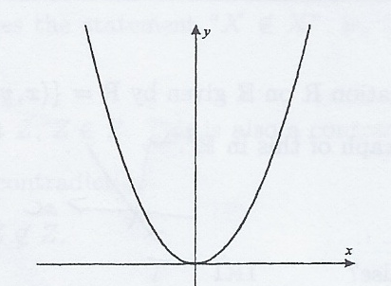
Infinite Case: Exercise
Which of the following relations are functions? A sketch might be handy!
(i) R₁ on ℝ, R₁ = {(x, y): y = x²}.
Yes, a function.
Justification/Proof:
  For each x ∈ ℝ, y = x² ∈ ℝ, thus, (x, x² ) ∈ R₁. Hence, x ∈ Dom R₁. Hence, Dom R₁ = ℝ
  Furthermore, for each x ∈ ℝ, there is a unique value x² value in ℝ such that (x, x² ) ∈ R_{1.}
  Therefore R₁, is a function.

Slide 49
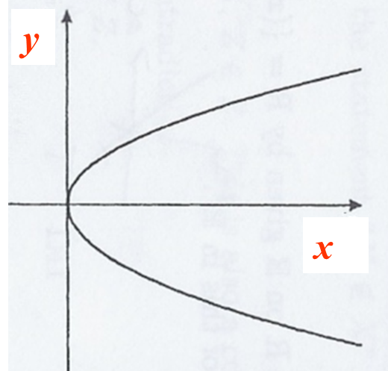


Infinite Case: Exercise
(ii) R₂ on ℝ, R₂ = {(x, y): x = y²}.
Dom R₂ = {x ∈ ℝ: x ≥ 0}
Since Dom R₂ ⊂ ℝ, R₂ is not a function.
Justification:
  If x < 0, as y² is always nonnegative, hence, there is no y ∈ ℝ such that x = y² ∈ ℝ, hence, x ∉ Dom R₂.
  If x ≥ 0, we take y = $\sqrt{x}$, then x = = y². Hence, (x, y) ∈ R_{2.}
  Therefore, Dom R₂ = {x ∈ ℝ: x ≥ 0}
  Since Dom R₂ ⊂ ℝ, R₂ is not a function.
$\left(\sqrt{x} \right)$²

Slide 50
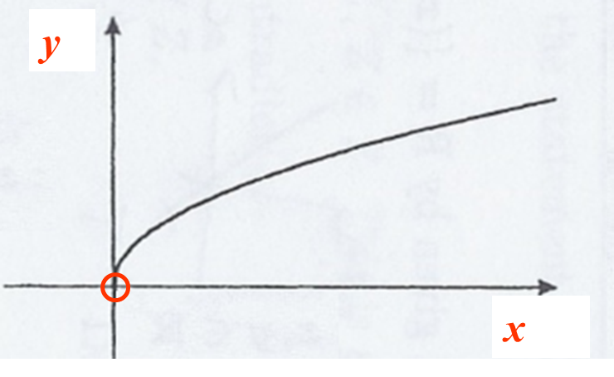


Infinite Case: Exercise
(iii) R₃ on A = {x ∈ ℝ: x > 0}, R₃ = {(x, y): x = y²}.
Dom R₃ = {x ∈ ℝ: x > 0}.
Since it satisfies the vertical line test, R₃ is a function.
Justification/Proof:
For each x ∈ A, as x ≥ 0, we can take y = $\sqrt{x}$, then x = = y². Hence, (x, y) ∈ R_{3.}
Hence, Dom R₃ = A
As each vertical line in this graph intersects the curve exactly one point, hence, for each element x ∈ A, there is only one value y ∈ A, such that (x, y) ∈ R₃ .
Therefore R₃ is a function.
$\left(\sqrt{x} \right)$²

Slide 51
Finite Case: Exercises
Let A = {2, 4, 6} and let B = {1, 3, 5}. Consider the following relations from A to B.
1. R₁ = {(x, y): x + 1 = y} = {(2, 3), (4, 5)}.
Dom R₁ = {2, 4} ≠ A.
Thus, R₁ is not a function.
2. R₂ ={(2, 5), (4, 1), (4, 5), (6, 5)}.
Dom R₂ = {2, 4, 6} = A.
However, 4 is related to both 1 and 5.
Thus R₂ is not a function.

Slide 52
Finite Case: Exercises
Let A = {2, 4, 6} and let B = {1, 3, 5}. Consider the following relations from A to B.
3. R₃ = {(2, 5), (4, 1), (6, 5)}.
Dom R₃ = A and each first element only appears once.
Thus, R₃ is a function.
For Finite Cases, we can also use diagrammatical method shown in Appendix 1 to check. However, for justification/proof, we should follow the method used in these exercises.

Slide 53
One-To-One Functions
Let f: A → B be a function. f is one-to-one if and only if
∀x₁, x₂ ∈ A, (f(x₁) = f(x₂) ⇒ x₁ = x₂).

Slide 54
Verifying/Proving One-to-One Function
Verifying/proofing a function f from A to B is a one-to-one function:
  Follow an appropriate method of proof.
  Verify that an element in the range is related to a unique element in the domain.
Finite Case:
  Can use the diagrammatical method illustrated in Appendix 1 as a working tool to verify, but for proof, we must present it according to the method of proof.
Infinite Case:
  For (x₁, y₁), (x₂, y₂) ∈ F, based on the rule of F, if y₁ = y₂, is x₁ = x₂?
  The above verification/proof can be replaced by the horizontal line test.

Slide 55
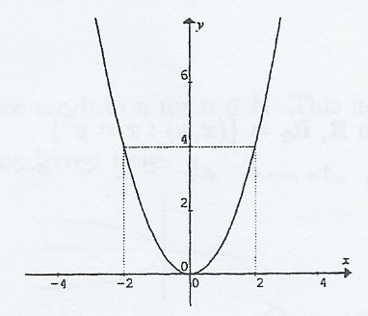
One-To-One Functions: Example
Consider the relation F on ℝ given by
F = {(x, y): y = x²}.
F is a function, but some
of the elements in the
y position are related to
two elements in the domain.
Hence, F is not a one-to-one
function.
Justification/Proof of Not One-to-One:
  Since F(3) = 9 and F(-3) = 9, but 3 ≠ -3, hence, F is not one-to-one.

Slide 56
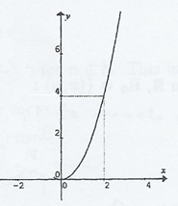
One-To-One Functions: Example
Consider the relation F on ℝ⁺ = {x ∈ ℝ: x > 0} given by
F = {(x, y): y = x²}.
Any given element from the range is
the image of only one element from the
domain. Therefore, F is a one-to-one
function, as each element in the range is
the image of only one element
in the domain.
Justification/Proof of One-to-One:
  For each x₁, x₂ ∈ ℝ⁺ such that (f(x₁) = f(x₂), x₁² = x₂² .
  As both x₁> 0 and x₂ > 0, this implies that x₁ = x₂.
  Hence, F is one-to-one.

Slide 57
One-To-One Functions: Notes
For checking a function from A to B to see whether it is one-to-one:
  Infinite case: Can also be checked or proved by the horizontal line test.
Finite case: Is each element in the range always associated with a different element in the domain? (refer to Appendix 1).

Slide 58
Exercises:
Which of the following are one-to-one functions?
(i) F₁ on A = {1, 2, 3}, F₁ = {(1, 2), (2, 3), (3, 1)}.
Yes
(ii) F₂ on A = {1, 2, 3}, F₂ = {(1, 2), (2, 1), (3, 1)}.
No, since the both the first element 2 and 3 have the same image 1.

Slide 59

Exercise:
Which of the following functions are one-to-one functions?
(iii) F₃ on ℤ, F₃ = {(x, y): y = 2x}.
Yes
Proof/Justify: If there are x_{1 ,} x₂∈ ℤ such that F₃ (x₁) =F₃ (x₂)
  Then, 2x₁ = 2x₂
  Hence, x₁ = x₂
  Therefore, F₃ is one-to-one
(iv) F₄ from ℤ - {0} to ℝ, F₄ = {(x, y): y = }.
No, since both the first element -1 and 1 have the same image 0.
$$\sqrt{x^{2}−1}$$

Slide 60
Onto Functions
Let f: A → B be a function.
f is onto if and only if
Range f = B,
that is,
∀y ∈ B, ∃x ∈ A, y = f(x).

Slide 61
Verifying/Proving Onto Function
Verifying/proofing a function f from A to B is a Onto:
  Follow an appropriate method of proof.
  Verify that an element in the codomain B is related to an element in the domain A.
Finite Case:
  Can use the diagrammatical method illustrated in Appendix 1 as a working tool to verify, but for proof, we must present it according to the method of proof.
Infinite Case:
  For y ∈ B, based on the rule of F, show that there is a solution x ∈ A satisfying the rule.

Slide 62
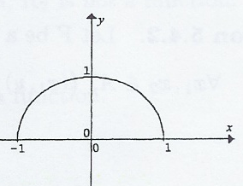


Onto Functions: Example
Let F be a function from A = {x ∈ ℝ: -1 ≤ x ≤ 1} to A given by
F (x) = .
Dom F = [-1, 1]
Range F = [0, 1]
This function is clearly not onto as range F ≠ A.
$$\sqrt{1−x^{2 }}$$
Justification/Proof of Not Onto:
  -1 ∈ A, as F(x) = ≥ 0, hence, there is no x ∈ A such that F(x) = -1.
  Thus, -1 ∉ range F.
  Hence, range F ≠ A.
  Therefore, F is not onto.
$$\sqrt{1−x^{2 }}$$

Slide 63


Onto Functions: Example
A = {x ∈ ℝ: -1 ≤ x ≤ 1}
However, we can define B = {y ∈ ℝ: 0 ≤ y ≤ 1}, and a “new” function f₁: A → B, given by the same rule as F, that is,
f₁(x) = .
A = {x ∈ ℝ: -1 ≤ x ≤ 1}
Dom F = [-1, 1]
Range F = [0, 1]
  Proof:
  For each y ∈ B, let x = ∈ A, then y = f₁(x).
  Thus, Range f₁ = B.
Hence, f₁ is onto.
$$\sqrt{1−x^{2}}$$
$$\sqrt{1−y^{2 }}$$

Slide 64
Onto Functions: Notes
1. To show a function f: A → B is onto, you simply need to show that Range f = B, that is, for each element y ∈ B, come up with an element x ∈ A such y = f(x).
2. To prove that a function f: A → B is not onto, you just need to find one element y ∈ B which is not the image of any x ∈ A.

Slide 65
Exercise:
Determine which of the following functions are onto.
Let A = {1, 2, 3, 4, 5} and B ={a, b, c, d}.
(i) f₁: A → B, f₁ = {(1, a), (2, c), (3, c), (4, d), (5, d)}
No, b ∈ B but it is not an image of any element in A.
(ii) f₂: A → B, f₂ = {(1, a), (2, b), (3, c), (4, d), (5, a)}
Yes, since range f₂ = B.

Slide 66
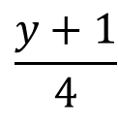
Exercise:
Determine which of the following functions are onto.
(iii) f₃: ℝ → ℝ such that f₃(x) = 4x -1.
  For each y ∈ ℝ, let x = ∈ ℝ, then y = f₃(x).
  Thus, Range f₃ = ℝ.
Hence, f₃ is onto
(iv) f₄: ℤ → ℤ such that f₄(x) = 4x – 1.
No, 0 ∈ ℤ but it is not an image of any element in the domain.
$$\frac{y+1}{4}$$

Slide 67
Onto Functions: Notes
If you are asked to show why a function is not onto, all you need to give is a counterexample, that is, you must give a value of
y ∈ B for which there is no x ∈ A to give y = f(x).
For example, for f₄ in the previous exercise,
f₄ is not onto.
For y = 1, we need x ∈ ℤ so that 1 = 4x – 1.
That is, we need 2 = 4x or x = ½.
However, ½ ∉ ℤ, so there is no x so that y = f₄(x).

Slide 68
Inverse Functions
For any function, there is an inverse relation, however, this inverse relation is not always a function.
The inverse relation of F will also be a function when F is one-to-one and onto.

Slide 69
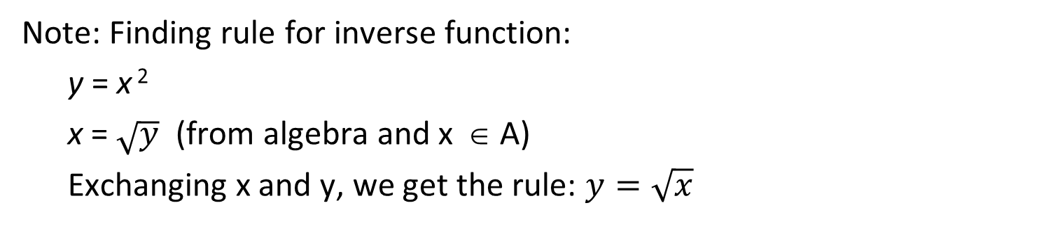
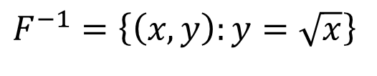
Exercise:
Sketch the function F from A = {x ∈ ℝ: x ≥ 0} to A given by
F = {(x, y): y = x²}.
Sketch F⁻¹. Find F⁻¹.
Is F⁻¹ a function?
y
F
1
F⁻¹
$$F^{−1}=\left\{\left(x,y\right):y=\sqrt{x}\right\}$$
0
1
x
F⁻¹ is a function since F is one-to-one and onto.
Note: Finding rule for inverse function:
  y = x ²
  x = $\sqrt{y}$ (from algebra and x ∈ A)
  Exchanging x and y, we get the rule: $y=\sqrt{x}$

Slide 70
Composition of Functions
Let f and g be two functions. Let the domains of f and g be S and T respectively. Let the codomains of f and g be T and U respectively. Then, we can define a composition function from S to U, called composition of f and g, denoted as g º f , as follows:
(g º f)(x) = g(f(x))
Example: f: ℝ → ℝ defined as f(x)= 2x; and g: ℝ → ℝ defined as g(x)= x². Then,
(g º f)(x) = g(f(x)) = g(2x) = (2x)² = 4x²
70

Slide 71
Appendix 1: Diagrammatical Checking of Finite Relations and Functions
Example: Checking relations R from X = {a, b, c, d } to Y = {1, 2, 3, 4, 5}
xRy is shown by an arrow from x to y
X
X
Y
First case:
a
b
c
d
1
2
3
4
5
not a function from X to Y:
domain of R ≠ X
R = {(a, 2), (b, 3), (c, 3)}
Second case:
X
X
Y
a
b
c
d
1
2
3
4
5
R = {(a, 2), (b, 3), (c, 4), (d, 5), (d, 1)}
not a function from X to Y:
due to dR1 and dR5
71

Slide 72
Appendix 1: Diagrammatical Checking Finite Relations and Functions (cont’d)
Example: Checking relations R from X = {a, b, c, d } to Y = {1, 2, 3, 4, 5}
Third case:
X
X
Y
a
b
c
d
1
2
3
4
5
R = {(a, 2), (b, 3), (c, 3), (d, 1)}
a function from X to Y but not one-to-one and also not onto
Fourth case:
X
X
Y
a
b
c
d
1
2
3
4
5
R = {(a, 2), (b, 3), (c, 4), (d, 1)}
a one-o-one function from X to Y but not onto
72

Slide 73
Appendix 1: Diagrammatical Checking Finite Relations and Functions (Cont’d)
Example: Checking a relation R from X = {a, b, c, d } to Y = {1, 2, 3, 4}
Fifth case:
X
X
Y
a
b
c
d
1
2
3
4
a one-o-one and onto function from X to Y
R = {(a, 2), (b, 3), (c, 4), (d, 1)}
73
73

Slide 74
End of Unit 5

